Slide 1

COMMUNICATION & PRESENTATION SKILLS (CPS) THEORY
Course Instructor : Ms Madiha Rehman
Week: 01
Course Code: SS152
Class Duration : 2 hrs. per week. (One hour each Class)
Duration of Week Class: 2 hrs.

Slide 2

DOWNLOAD EDMODO
Class Code
i2ew9d

Slide 3
Course Objective
Understand Communication from a technical and scientific perspective

Slide 4
CONTENTS (WEEK 1)
Definition of Communication
Communication Theory
Types of Communication
Process of Communication

Slide 5
What is Communication?
Suggest adjectives that describe communication

Slide 6
What is Communication?
Transfer of information & understanding from one person to another.
It is way of reaching others with thoughts, values, ideas & facts.

Slide 7
What is Communication?
It involves:
1. One Sender (an encoder)
2. A clear message ( it is sent by the sender)
3. A recipient (decoder)

Slide 8
Theory of Communication
Communication theory was proposed by S. F. Scudder in the year 1980. It states that all living beings existing on the planet communicate although the way of communication is different.
Plants communicate by showing visible changes
Animals and birds also communicate by producing sounds.
The silence of parents convey to the kid that they are angry on him

Slide 9
The Essence of Communication
Personal process
Occurs between people
Involves change in behavior
Means to influence others
Expression of thoughts and emotions through words & actions.
Tools for controlling and motivating people.
It is a social and emotional process.

Slide 10
TYPES OF COMMUNICATION

Slide 11
Types of Communication
Verbal/spoken Communication
Non-Verbal Communication
Written Communication
Listening Communication
Visual/Graphical Communication
Interpersonal Communication
Intrapersonal Communication
Public Communication
Mass Communication
Organizational Communication

Slide 12

Types of Communication
VERBAL/SPOKEN COMMUNICATION
When two people/a group engage in speaking
It can be:
Face to face
Telephone
Video call through any medium

Slide 13
Types of Communication
VERBAL/SPOKEN COMMUNICATION
Verbal communication involves two kinds of engagement
Informal Verbal Engagement
Chatting with friends
Formal Verbal Engagement
Scheduled meetings

Slide 14
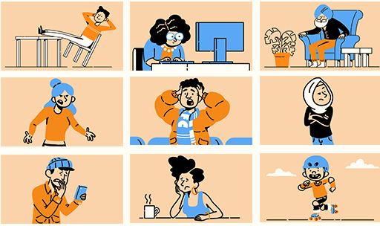
Types of Communication
NON-VERBAL COMMUNICATION

Slide 15

Types of Communication
NON-VERBAL COMMUNICATION
It includes:
Facial expression
Posture
Eye-contact
Hands/ body Movement
Tracking pattern
Speech mannerism

Slide 16

Types of Communication
Written Communication
It includes:
Email
Memos
Report
Twitter

Slide 17

Types of Communication
Listening Communication
It includes:
Active listening is important
Without listening, we can not engage with the speaker effectively.

Slide 18

Types of Communication
Visual/Graphical Communication
It includes:
Facebook
Instagram
Use imagery to sell items

Slide 19
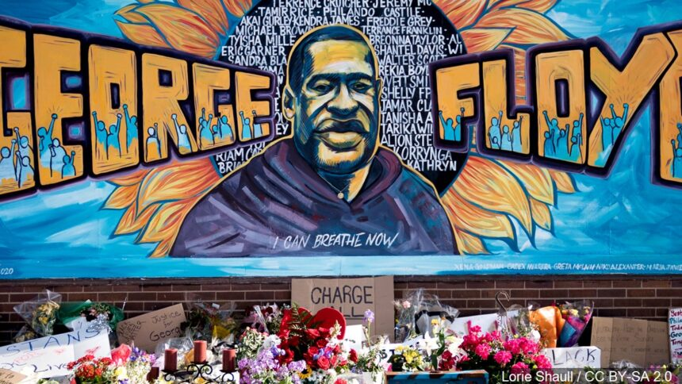
Types of Communication
Visual/Graphical Communication

Slide 20

Types of Communication
Visual/Graphical Communication

Slide 21
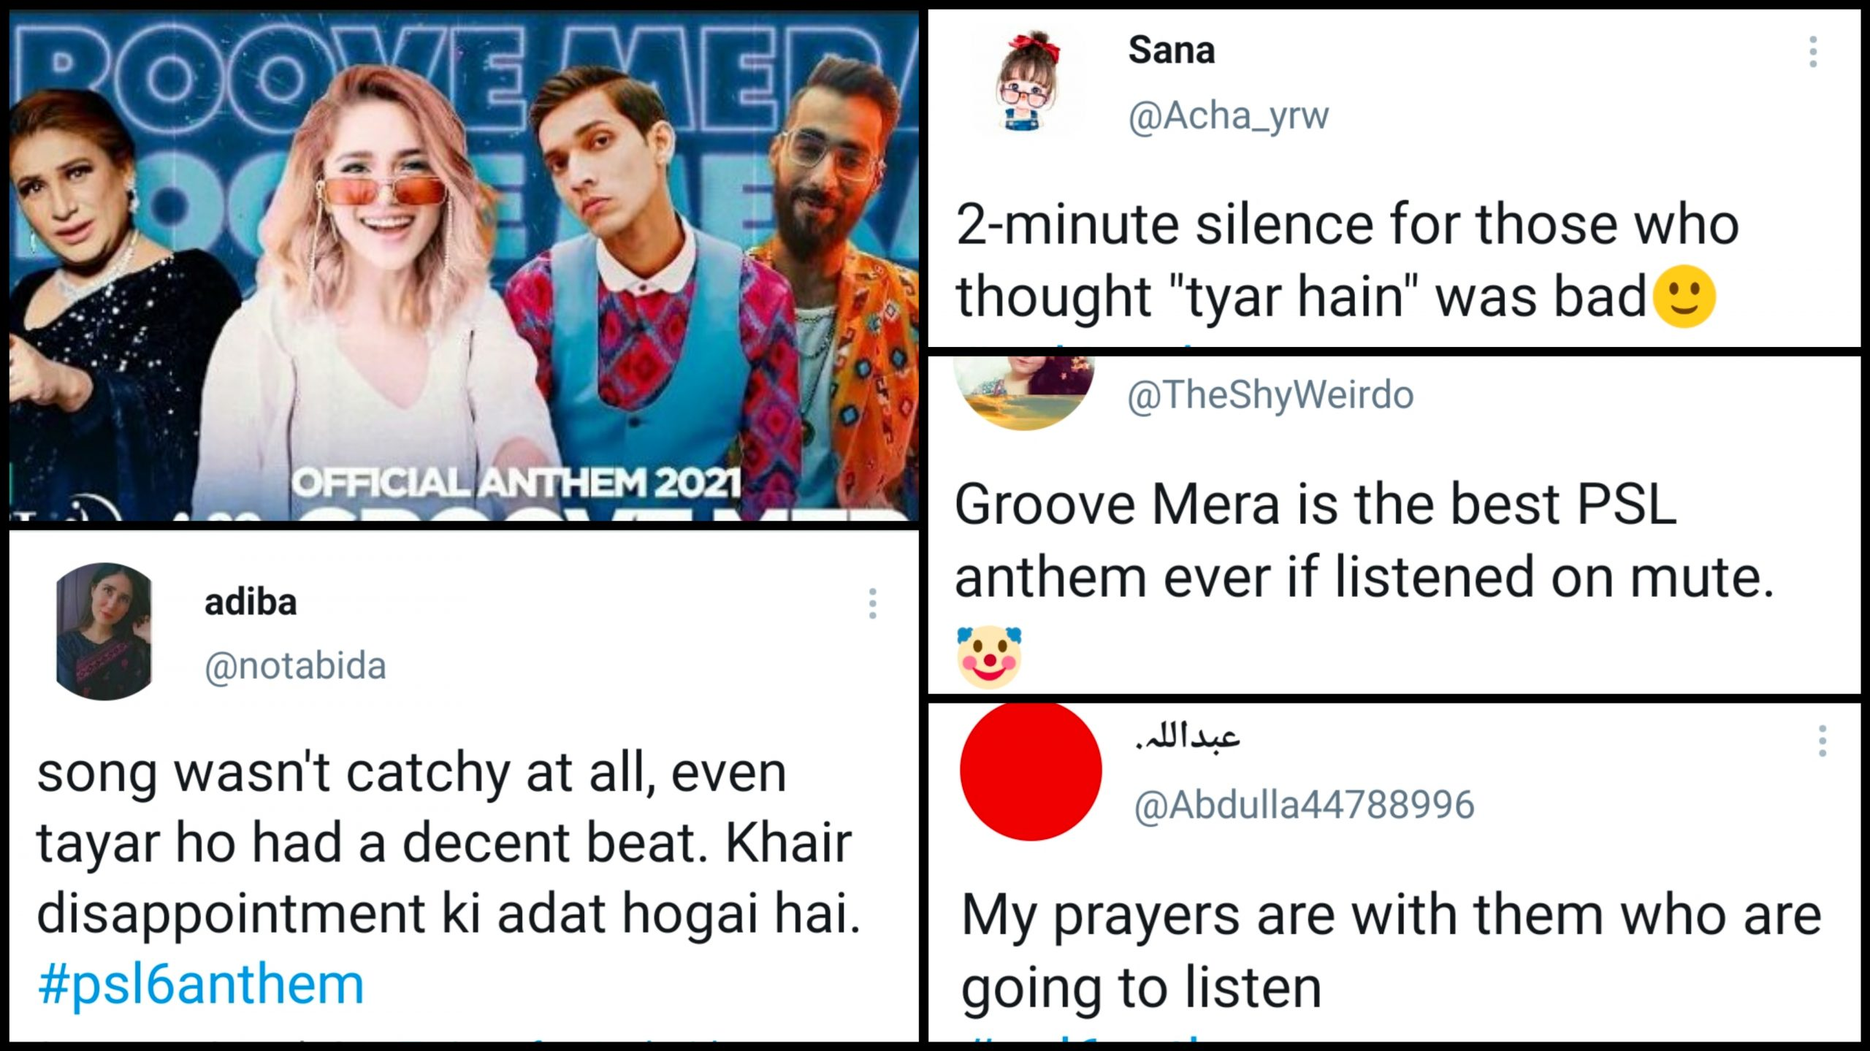
Types of Communication
Visual/Graphical Communication

Slide 22

Types of Communication
Interpersonal Communication
The Process of exchange of information,
feelings, ideas between two or more people
through Verbal or non-verbal method.

Slide 23
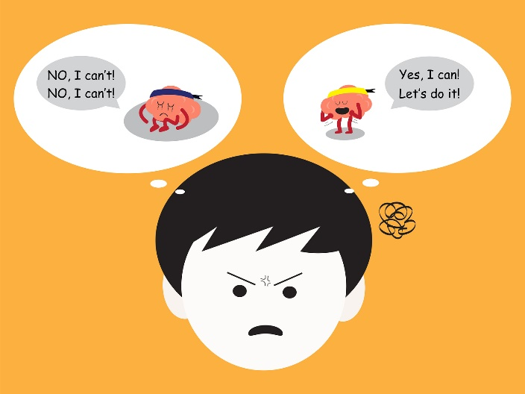
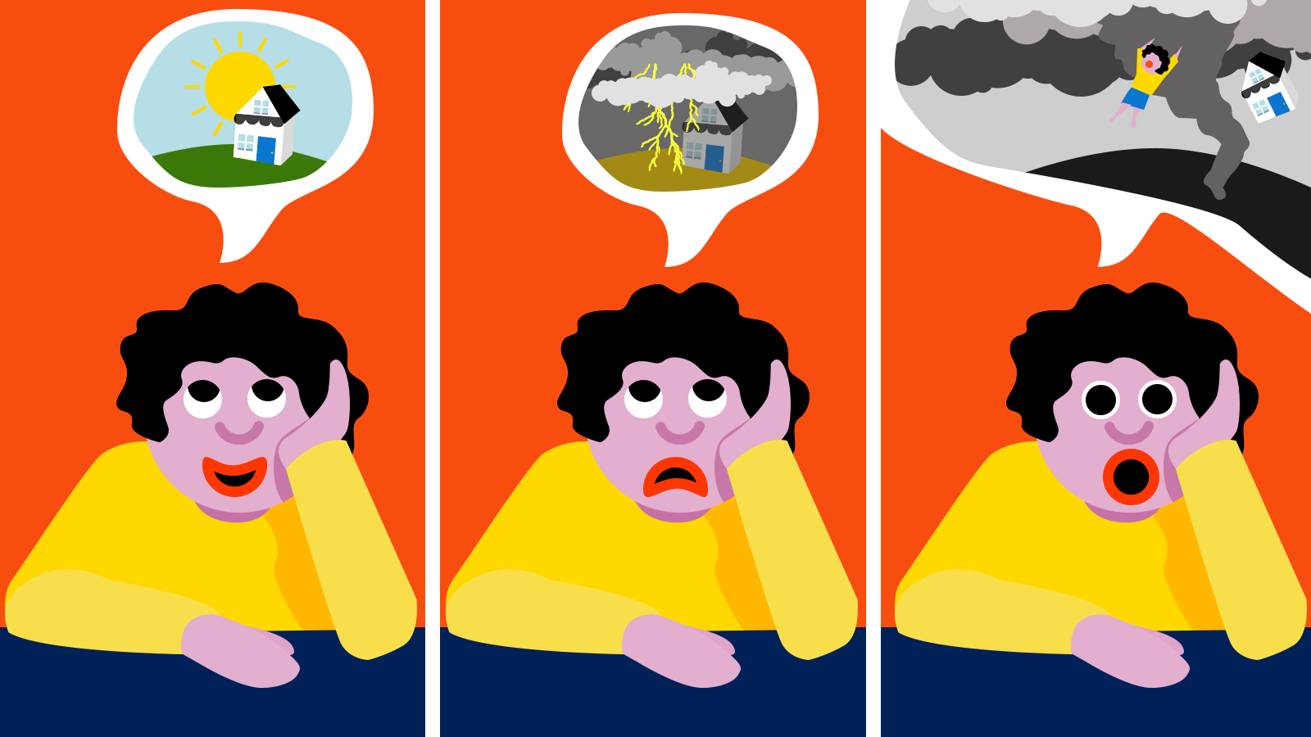
Types of Communication
Intrapersonal Communication
Communication with one’s self
Self-talk, recalling of the memory
Act of imagination
Visualization

Slide 24
Types of Communication
Intrapersonal Communication
Communication with one’s self
Self-talk, recalling of the memory
Act of imagination
Visualization
Solving complex problem in mind to
Thinking about what to wear today
or how to ask your parents for party etc.

Slide 25

Types of Communication
Public Communication
When people or group of people
Gather & start sharing information.
Giving presentation
Address to nation
Press conference
Radios
Television

Slide 26

Types of Communication
Mass Communication
The process by which people, group or organization creates a message and transmit it through some medium
to a large, anonymous,
heterogeneous audience
Examples:
commercial , Journalism,
Political campaign

Slide 27
Types of Communication
Mass Communication

Slide 28

Types of Communication

Slide 29

Types of Communication
ORGANIZATIONAL COMMUNICATION
It generates from one source and takes place when the organization communicates with a number of receivers.
This kind of communication can be made either to receivers within the organization, or to others outside the organization in the form of reports or meetings.

